Slide 1
Blacktown Chinese Christian Church
Welcome to Our English Service 15.09.2024
English Service 9:45 – 11:00 am
Worship Songs: Passage: Speaker: Topic: Response Song: Announcements and Closing Prayer Benediction
I Will Boast In Christ God So Loved Goodness Of God Romans 5:6-11 TBA TBA TBA

Slide 2
BCCC english service

Slide 3

Please keep all phones on silent

Slide 4
I Will Boast In Christ
Reuben Morgan, Scott Ligertwood © 2016 Hillsong Music Publishing Australia CCLI Licence No. 5485849 . CCLI Song number: 7068427

Slide 5
Verse 1
All I have because of Jesus
All this promise
Won for me

Slide 6
Verse 1
When He paid the highest ransom
Once for always
For my freedom

Slide 7
Chorus
I will boast, in Christ alone
His righteousness
And not my own

Slide 8
Chorus
I will cling to Christ my hope
His mercy reigns
Now and forever

Slide 9
Verse 2
Love will never lose its power
All my failures
Could not erase

Slide 10
Verse 2
And now I walk within Your favour
Grace unending
My salvation

Slide 11
Chorus
I will boast, in Christ alone
His righteousness
And not my own

Slide 12
Chorus
I will cling to Christ my hope
His mercy reigns
Now and forever

Slide 13
Bridge 1
What can wash away my sin?
Nothing but the blood of Jesus
What can make me whole again?
Nothing but the blood of Jesus

Slide 14
Bridge 2
What can wash away my sin?
Nothing but the blood of Jesus
What can make me whole again?
Nothing but the blood of Jesus

Slide 15
Bridge 2
Nothing but the blood of Jesus

Slide 16
Chorus
I will boast, in Christ alone
His righteousness
And not my own

Slide 17
Chorus
I will cling to Christ my hope
His mercy reigns
Now and forever

Slide 18
Bridge
What can wash away my sin?
Nothing but the blood of Jesus
What can make me whole again?
Nothing but the blood of Jesus

Slide 19
Outro
O precious is the flow
That makes me white as snow
No other fount I know
Nothing but the blood of Jesus

Slide 20
Outro
Nothing but the blood of Jesus

Slide 21
God So Loved
CCLI Licence No: 5485849

Slide 22
Chorus
For God so loved the world
That He gave His only Son
And whosoever believes will not perish
They shall have eternal life

Slide 23
Verse 1
I shall hold to the cross
I shall hold to God alone
For His love has salvaged me
For His love has set me free

Slide 24
Chorus
For God so loved the world
That He gave His only Son
And whosoever believes will not perish
They shall have eternal life

Slide 25
Verse 2
I shall wait upon the Lord
I shall wait upon His word
And by His grace, I am released
And by His grace, I am redeemed

Slide 26
Chorus
For God so loved the world
That He gave His only Son
And whosoever believes will not perish
They shall have eternal life

Slide 27
Interlude

Slide 28
Bridge
And by His precious blood, I have been set free
For the glory of Jesus' name
I surrender all, now to Christ alone
In Jesus, I am saved

Slide 29
Bridge
By His precious blood, I have been set free
For the glory of Jesus' name
I surrender all, now to Christ alone
In Jesus, I am saved

Slide 30
Chorus
For God so loved the world
That He gave His only Son
And whosoever believes will not perish
They shall have eternal life

Slide 31
Chorus
Yes, they shall have eternal life

Slide 32
Goodness Of God
Ben Fielding, Brian Johnson, Ed Cash, Jason Ingram, Jenn Johnson © Bethel Music Publishing (Admin. by SHOUT! Music Publishing Australia) CCLI Licence No. 5485849 . CCLI Song number: 7117726

Slide 33
Verse 1
I love You, Lord
For Your mercy never fails me
All my days, I've been held in Your hands

Slide 34
Verse 1
From the moment that I wake up
Until I lay my head
Oh, I will sing of the goodness of God

Slide 35
Chorus
All my life You have been faithful
And all my life You have been so, so good
With every breath that I am able
Oh, I will sing of the goodness of God

Slide 36
Verse 2
I love Your voice
You have led me through the fire
And in darkest night You are close like no other

Slide 37
Verse 2
I've known You as a Father
I've known You as a Friend
And I have lived in the goodness of God

Slide 38
Chorus
All my life You have been faithful
And all my life You have been so, so good
With every breath that I am able
Oh, I will sing of the goodness of God

Slide 39
Bridge
Your goodness is running after, it's running after me
Your goodness is running after, it's running after me

Slide 40
Bridge
With my life laid down, I'm surrendered now
I give You everything
Your goodness is running after, it's running after me

Slide 41
Bridge
Your goodness is running after, it's running after me
Your goodness is running after, it's running after me

Slide 42
Bridge
With my life laid down, I'm surrendered now
I give You everything
Your goodness is running after, it's running after me

Slide 43
Chorus
All my life You have been faithful
And all my life You have been so, so good
With every breath that I am able
Oh, I'm gonna sing of the goodness of God

Slide 44
Chorus
All my life You have been faithful
And all my life You have been so, so good
With every breath that I am able
Oh, I'm gonna sing of the goodness of God

Slide 45
Tag
Oh, I'm gonna sing of the goodness of God

Slide 46

Bible reading

Slide 47
Bible reading: Romans 5:6-11
⁶ You see, at just the right time, when we were still powerless, Christ died for the ungodly. ⁷ Very rarely will anyone die for a righteous person, though for a good person someone might possibly dare to die.

Slide 48
Bible reading: Romans 5:6-11
⁸ But God demonstrates his own love for us in this: While we were still sinners, Christ died for us.
⁹ Since we have now been justified by his blood, how much more shall we be saved from God’s wrath through him!

Slide 49
Bible reading: Romans 5:6-11
¹⁰ For if, while we were God’s enemies, we were reconciled to him through the death of his Son, how much more, having been reconciled, shall we be saved through his life! ¹¹ Not only is this so, but we also boast in God through our Lord Jesus Christ, through whom we have now received reconciliation.

Slide 50
Announcements

Slide 51





Account name: Blacktown Chinese Christian Church
Account number: 4216 50263
Offering
BSB: 112 - 879
Please put in "offering" as the reference
The offering box is available at the back of the hall

Slide 52
Prayer points

Slide 53
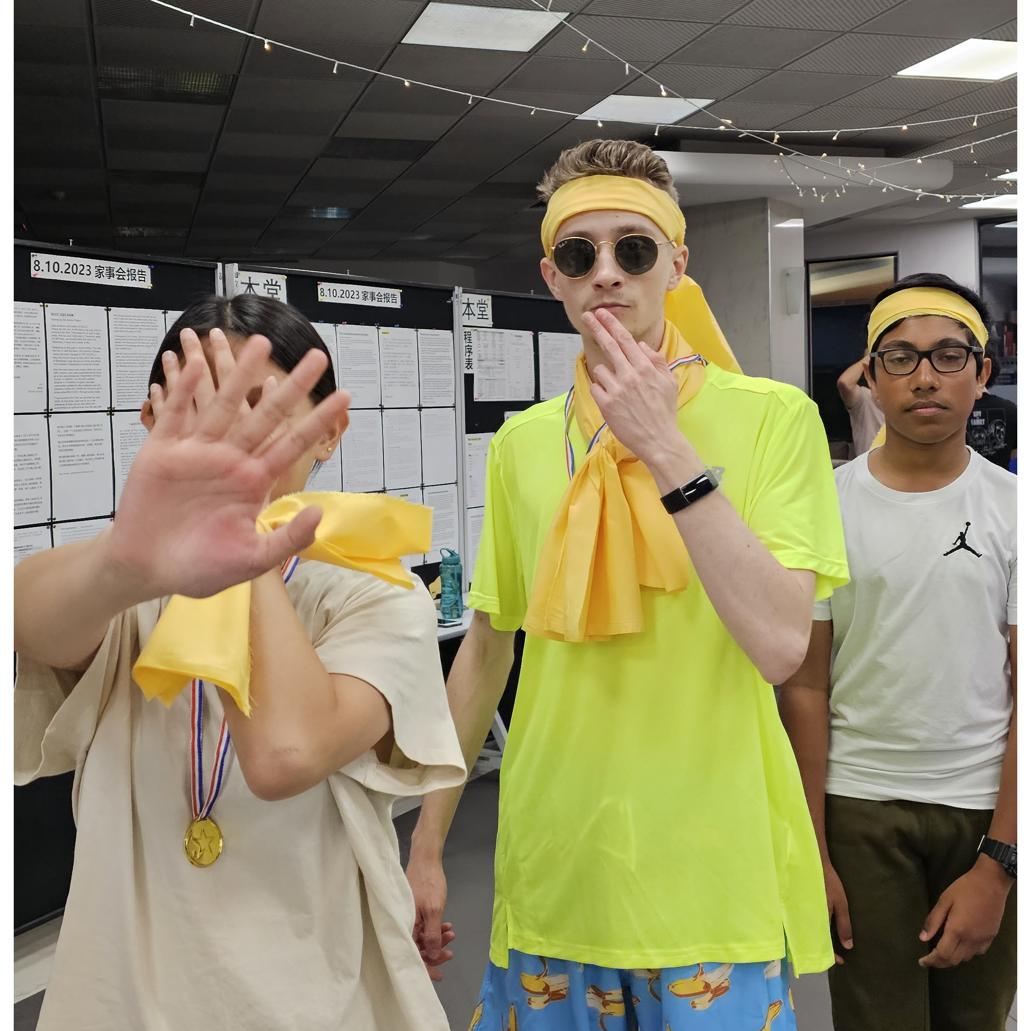
Mingle time!

